Slide 1
Cryptocurrency analysis

Slide 2
Digital currency
Bitcoin
Litecoin
Ethereum
Exploring possible external factors affecting recent cryptocurrency price data
News
Other currencies
Etc…

Slide 3
Daily closing price data for three digital currencies
Currencies: Bitcoin, Litecoin, Ethereum
Data source: https://coinmetrics.io/data-downloads/
News dataset to be used in exploring external factors
Google Trends: https://trends.google.com
Worldwide
Search terms: Bitcoin, Litecoin, Ethereum, Facebook Libra, cryptocurrency
Data is a WEEKLY google metric

Slide 4
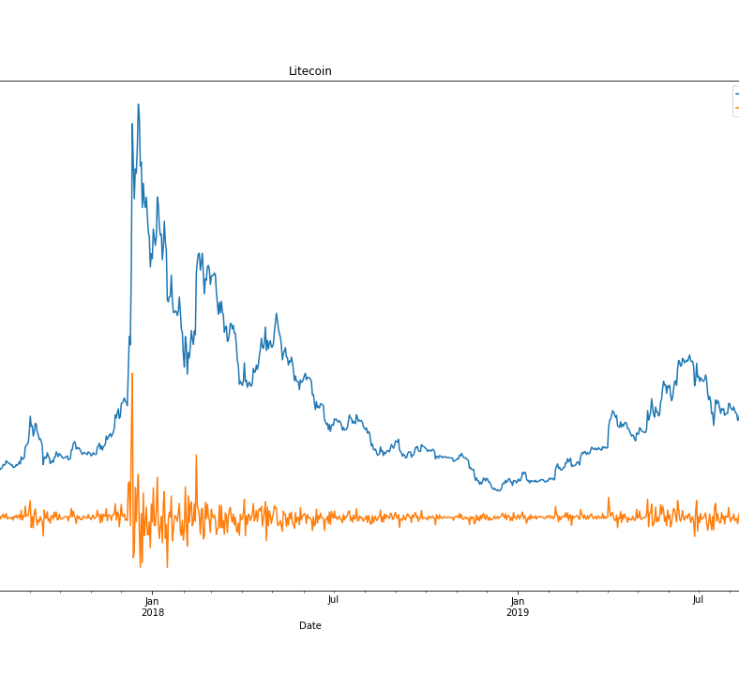
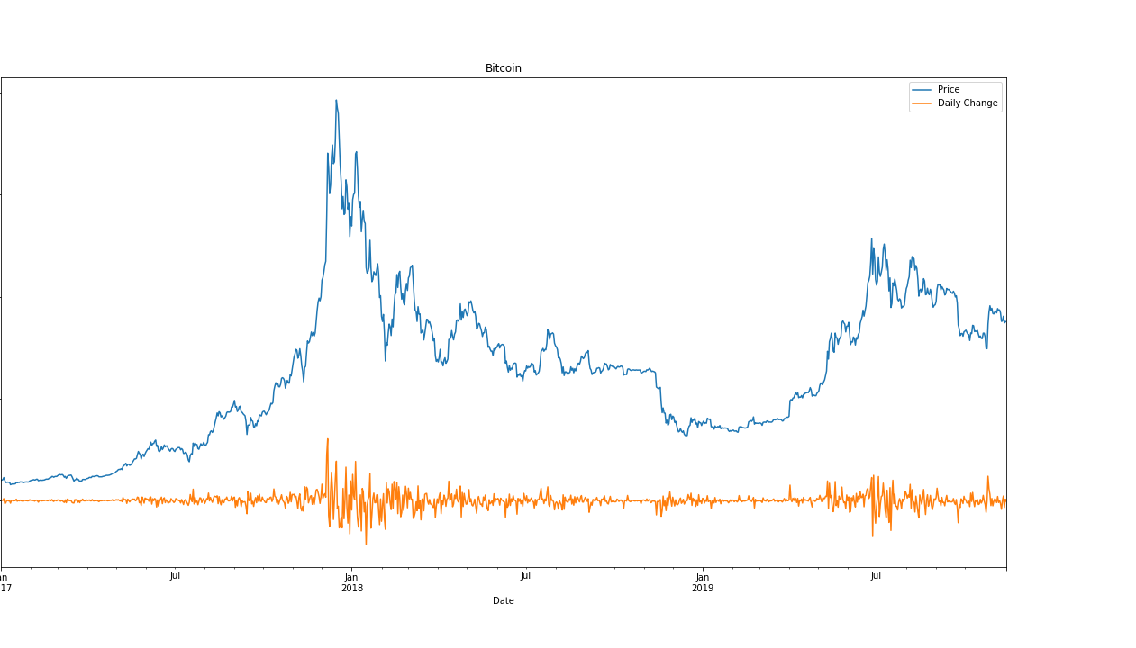
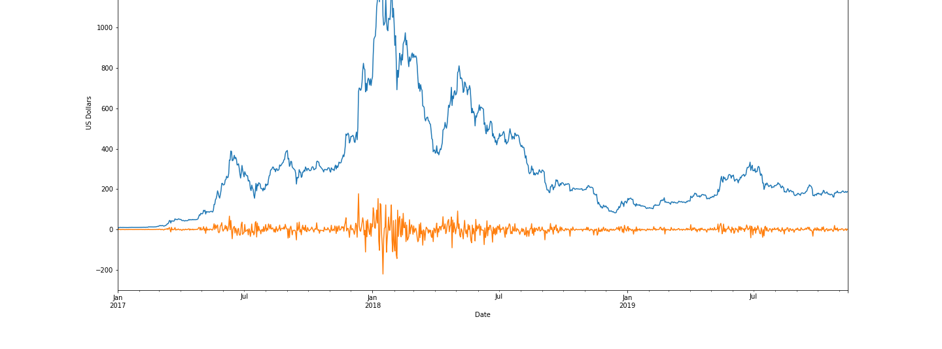

Slide 5

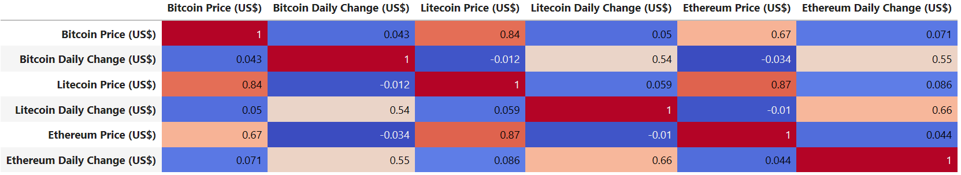
Cryptocurrency Price & Daily Change Correlations
Litecoin wins!

Slide 6

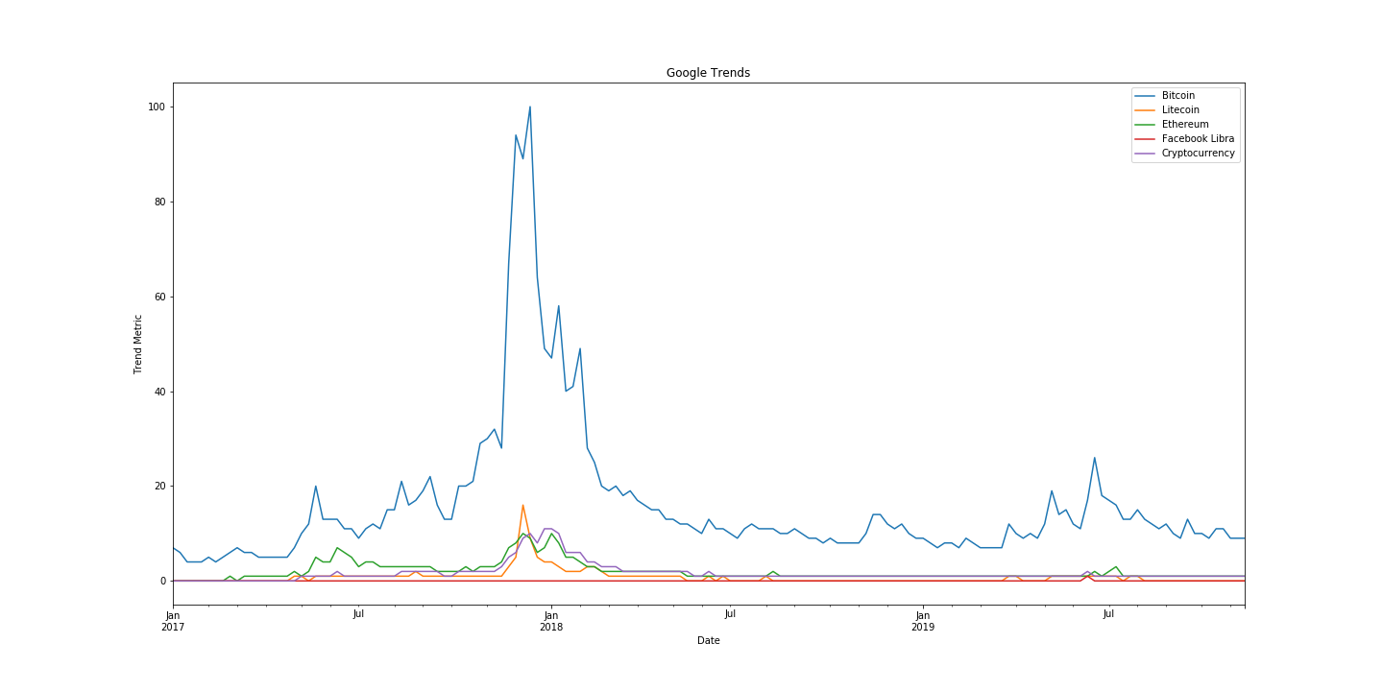

Slide 7
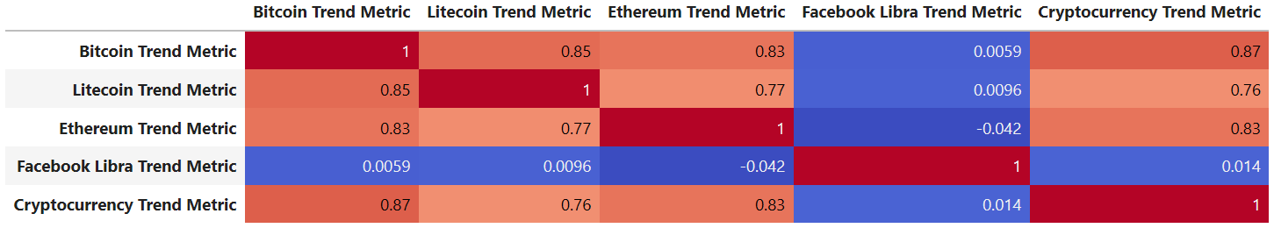
Google Trends Metric Correlations
Bitcoin wins!

Slide 8
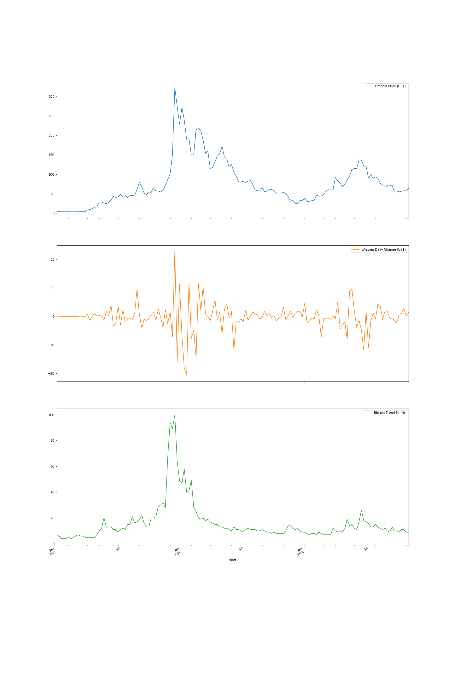

Slide 9
2017

Slide 10
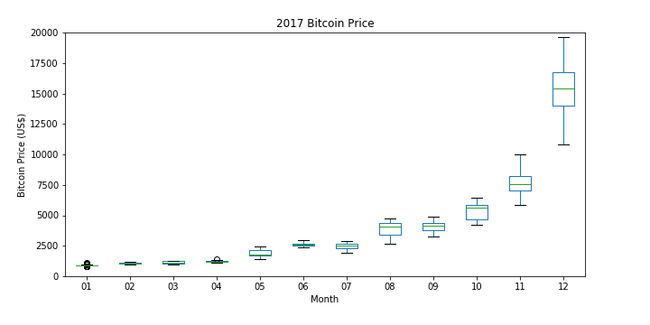

Slide 11
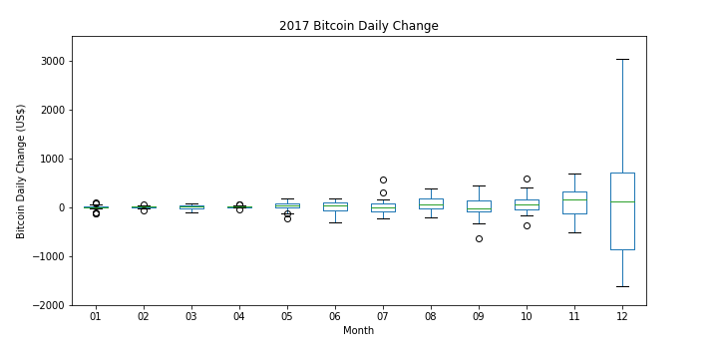

Slide 12
2018

Slide 13
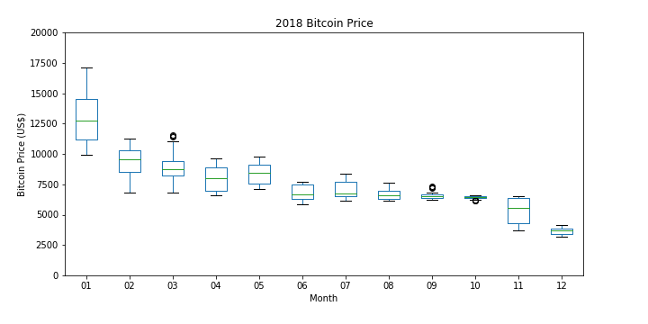

Slide 14
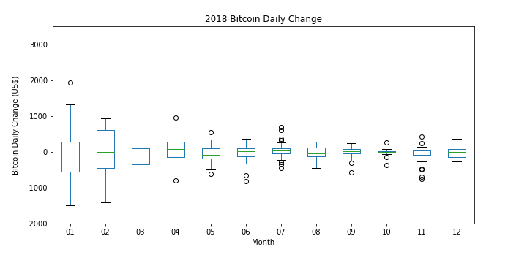

Slide 15
2019

Slide 16
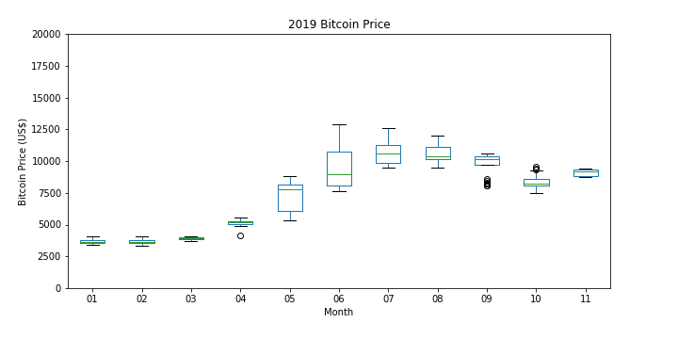

Slide 17
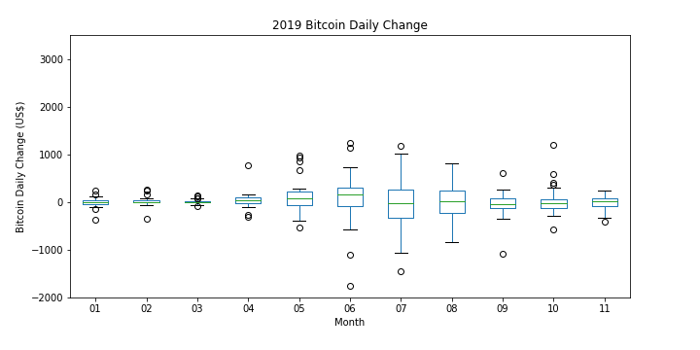

Slide 18
Take away
The monthly mean daily change of bitcoin is low
Higher prices lead to more volatile daily changes
HOWEVER the monthly mean daily change is stable
Google Trends algorithm for bitcoin in 2017 to 2019 corresponds with the price of bitcoin

Slide 19
Next Steps
Look into other external factors
Investigate outliers
Investigate twitter data
Conduct trend analysis
Lag analysis

Slide 20
Create presentation graphics

